Slide 1
Hackathon 2023
“Welcome to the future of problem-solving with our Generative AI Chatbot powered by LLM Based Models”
Redefining Efficiency: Revolutionizing Workspace Problem-Solving with our AI Chatbot
Theme : Operational Improvements Design with Measurable Benefit
Team Members:
Mahendra Chavan
Gourav Jain
Alok Ranjan
Sabyasachi Das
Notes:
Welcome to a groundbreaking presentation that unveils the future of workplace efficiency and problem-solving - the Generative AI Chatbot powered by LLM Based Models. We're on the brink of revolutionizing day-to-day operations with an intelligent solution that's swift, reliable, and ready to assist you round the clock.

Slide 2
Problem Statement
Employees face daily challenges
Technical glitches
Operational roadblocks
Traditional problem-solving is less efficient
Time-consuming back-and-forth
Waiting for someone with the answer
Causes delays, frustration, lost productivity
There must be a better way
An intelligent assistant
Available anytime
Provides swift solutions
Reduces human effort
Increases productivity
The future is automation
AI can handle repetitive tasks
Chatbots can provide instant support
Automation enables employees to focus on core responsibilities
Notes:
Every day, employees and project teams face a myriad of challenges - from technical glitches to operational roadblocks. The traditional routes to resolution can be time-consuming, involving a lot of back-and-forths, and waiting for someone who has the answer. This often leads to delays, frustration, and a dip in productivity. But what if there was a smarter way to tackle these obstacles?

Slide 3
The Solution: Our Generative AI Chatbot
Introducing our AI-powered chatbot built on LLM model
Acts as an intelligent virtual assistant
Provides instant answers and solutions 24/7
Handles technical queries
Addresses operational queries
Answers information requests
Customizable to our needs
Continuously improves with more data
Reduces reliance on human support
Boosts productivity
Optimized for seamless user experience
Integrates with our existing tools and systems
The future of workplace problem-solving is here
Notes:
Say hello to our powerful tool, the Generative AI Chatbot, which is here to redefine problem-solving. Built on the robust foundation of ChatGPT and LLM models, this chatbot is like an intelligent, virtual assistant, always ready to provide answers and solutions. Whether it's a technical issue, an operational query, or you're just looking for some information, our chatbot has got it covered.

Slide 4
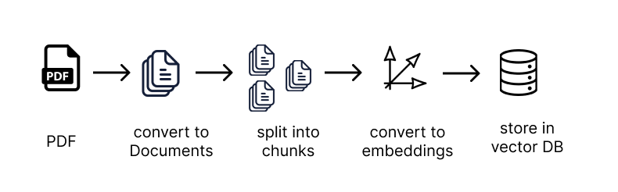
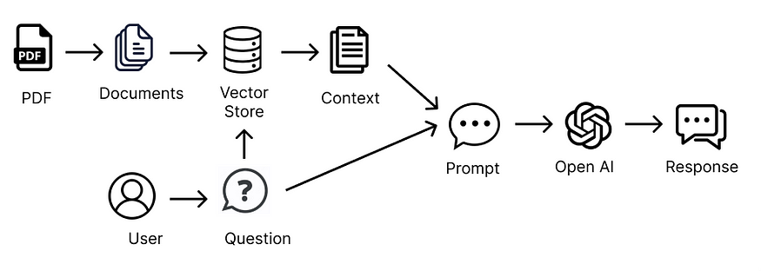
Working Mechanism

Slide 5
Working Mechanism
The chatbot works by extracting text from documents, passing it to LLM prompt along with a question, and getting LLM to generate an answer based on the document text.
It uses embeddings to encode the document text into vectors, stores them in a vector database, and only passes relevant snippets to LLM based on the question.
The vector database splits documents into chunks, generates embeddings for each chunk using embedding model, and stores them along with the original text.
To find relevant snippets, it matches the question embedding against stored embeddings using cosine similarity, retrieving the most similar chunks.
These relevant chunks are passed to LLM to provide context when answering the question.
And handles multiple document types like PDF, Word, text files by using different parsers.

Slide 6
Benefits for Employees
Enables Self-Service
Employees can independently find solutions
Reduces reliance on support teams
Promotes problem-solving skills
Saves Time
No more sifting through documents and manuals
Eliminates waiting for responses from others
Provides instant answers 24/7
Increases Productivity
Less time wasted on queries and issues
Quick access to information
More time for core tasks
Boosts Morale
Reduces frustration from lack of answers
Provides helpful assistant anytime
Empowers employees to succeed
Facilitates Learning
Grants access to large knowledge base
Answers lead to new insights
Fosters continuous education

Slide 7
Benefits for Projects
Swift Issue Resolution Can provides fast solutions to technical problems Can Reduces project delays and downtime | Proactive Problem Prevention Analyzes past issues to prevent recurrences Helps teams avoid potential pitfalls | Enhanced Collaboration Acts as central hub for problem-solving Enables collective team interaction Helps team learn to ask better and more insightful questions
Increased Efficiency Automates repetitive queries and tasks Frees up human resources for core work | Boosted Productivity Keeps projects on track with instant support Minimizes time wasted waiting for help | Data-Driven Innovation Sparks creative thinking with chatbot knowledge Automates research with quick access to findings The chatbot can analyze historical data to identify patterns and make data-driven forecasts about future outcomes.

Slide 8
Alignment with Hackathon Themes
Our AI Chatbot resonates strongly with the hackathon's key themes.
Solving Business or Operational Challenge
The chatbot serves as a reliable AI assistant, providing swift and accurate responses to operational and technical queries.
It reduces the time taken to resolve issues, enhancing operational efficiency and business productivity.
Operational Improvements Design with Measurable Benefit
The chatbot lessens the reliance on human intervention for problem-solving, potentially reducing operational costs.
Its benefits are quantifiable: time saved, issues effectively resolved, and noticeable improvement in operational efficiency.

Slide 9
Utilization and Benefits of the Idea/Hack
Our AI Chatbot's deployment offers extensive benefits that span across the organization:
For individual employees:
The chatbot serves as an easily accessible knowledge base and support system, fostering self-reliance and continuous learning.
For project teams:
The chatbot provides intelligent, data-driven solutions for technical and operational issues, boosting productivity and reducing downtime.
Beyond immediate problem-solving, the chatbot presents even more potential:
Its advanced data analysis capabilities can identify recurring issues or bottlenecks, providing valuable insights for long-term operational improvements.
This proactive approach to problem-solving has the potential to transform organizational operations, leading to increased efficiency and success.

Slide 10
Q & A

Slide 11


